Slide 1

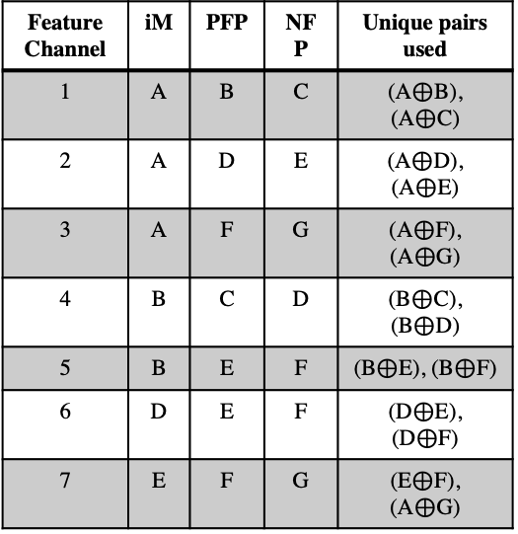









iM vectors constant per modality
FP constant per feature channel
Unoptimized
iM
FP
iM
FP
iM
FP
PFP₁
F_{1,j}
PFP₁
F_{1,j}
PFP₁
F_{1,j}
iM₁
NFP₁
SE_{1,j}
iM₁
NFP₁
SE_{1,j}
iM₁
NFP₁
$$⊕$$
SE_{1,j}
$$⊕$$
$$⊕$$
…
Modality 1
…
…
F_{k,j}
…
PFP_{k}
F_{k,j}
PFP_{k}
F_{k,j}
PFP₁
iM_{k}
NFP_{k}
SE_{k,j}
NFP_{k}
SE_{k,j}
iM_{k}
NFP₁
SE_{k,j}
$$⊕$$
iM_{k}
$$⊕$$
$$⊕$$
…
…
…
PFP_{n}
F_{n,j}
PFP_{n}
F_{n,j}
PFP_{n}
F_{n,j}
iM_{n}
NFP_{n}
SE_{n,j}
NFP_{n}
SE_{n,j}
NFP_{n}
$$⊕$$
SE_{n,j}
$$⊕$$
iM₁
$$⊕$$
iM₁
…
Modality m
…
…
…
PFP_{p}
F_{p,j}
PFP_{p}
F_{p,j}
PFP_{n}
F_{p,j}
iM_{p}
NFP_{p}
SE_{p,j}
NFP_{p}
SE_{p,j}
iM_{k}
NFP_{n}
SE_{p,j}
$$⊕$$
iM_{k}
$$⊕$$
$$⊕$$
(a)
(b)
(c)
Stored
Vectors
Feature Channel | iM | PFP | NFP | Unique pairs used
1 | A | B | C | (A$⊕$B), (A$⊕$C)
2 | A | D | E | (A$⊕$D), (A$⊕$E)
3 | A | F | G | (A$⊕$F), (A$⊕$G)
4 | B | C | D | (B$⊕$C), (B$⊕$D)
5 | B | E | F | (B$⊕$E), (B$⊕$F)
6 | D | E | F | (D$⊕$E), (D$⊕$F)
7 | E | F | G | (E$⊕$F), (A$⊕$G)
A B
C D
E F
G

Slide 2
: Signal
: HD vector
Modality 1 features
Modality 2 features
Modality 3 features
Map into HDS
Map into HDS
Map into HDS
Spatial Encoder
Spatial Encoder
Spatial Encoder
Temporal
Encoder
Temporal
Encoder
Temporal
Encoder
Fusion
Associative Memory
Inferred labels
(a)
Modality 1 features
Modality 2 features
Modality 3 features
Map into HDS
Map into HDS
Map into HDS
Spatial Encoder
Spatial Encoder
Spatial Encoder
Fusion
Temporal
Encoder
Associative Memory
Inferred labels
(b)

Slide 3









$⊕$: binding
: Signal
: HD vector
[+]
: bundling
$ρ$^{n}
: nth permutation
Features from modality 1
F_{1,j}
…
PFP₁
>0
NFP₁
<=0
$$⊕$$
SE_{1,j}
iM₁
F_{k,j}
…
[+]
PFP_{k}
>0
NFP_{k}
<=0
SE_{k,j}
…
iM_{k}
$$⊕$$
Trained vectors
Features from modality m
…
[+]
SE_{j}
$ρ$⁰
$$⊕$$
TE_{j}
Inferred labels
F_{n,j}
Hamming distance
…
PFP_{n}
>0
$ρ$¹
NFP_{n}
<=0
SE_{n,j}
…
iM_{n}
$$⊕$$
F_{p,j}
…
[+]
PFP_{p}
>0
$ρ$^{n}
NFP_{p}
<=0
SE_{p,j}
iM_{p}
$$⊕$$
Map into HDS
Spatial Encoder
Fusion
Temporal Encoder
Associative Memory

Slide 4
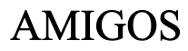
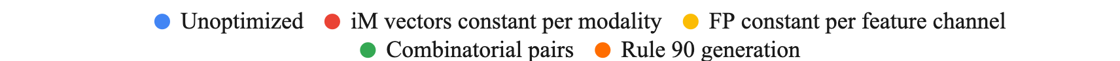
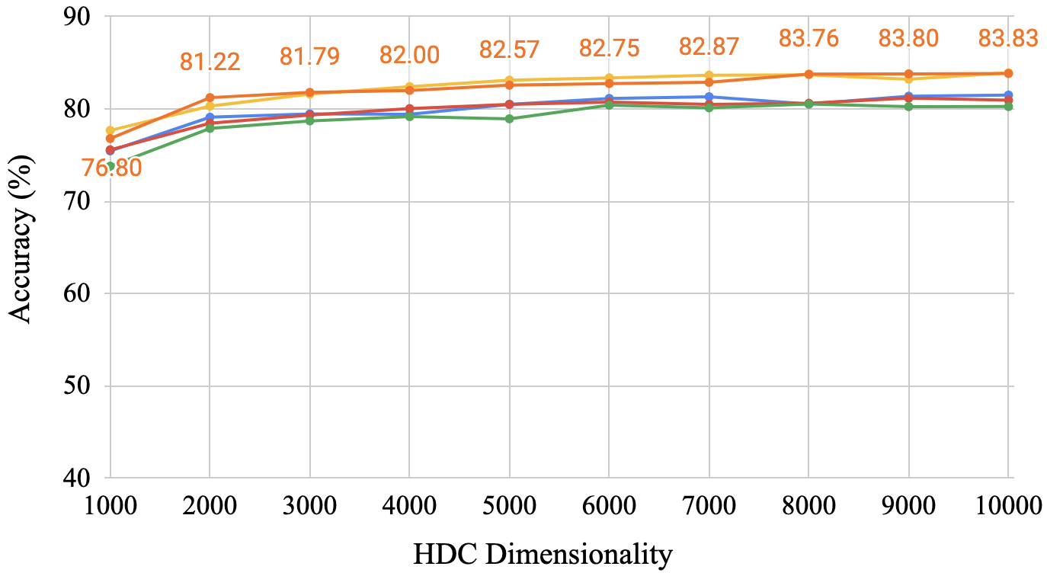
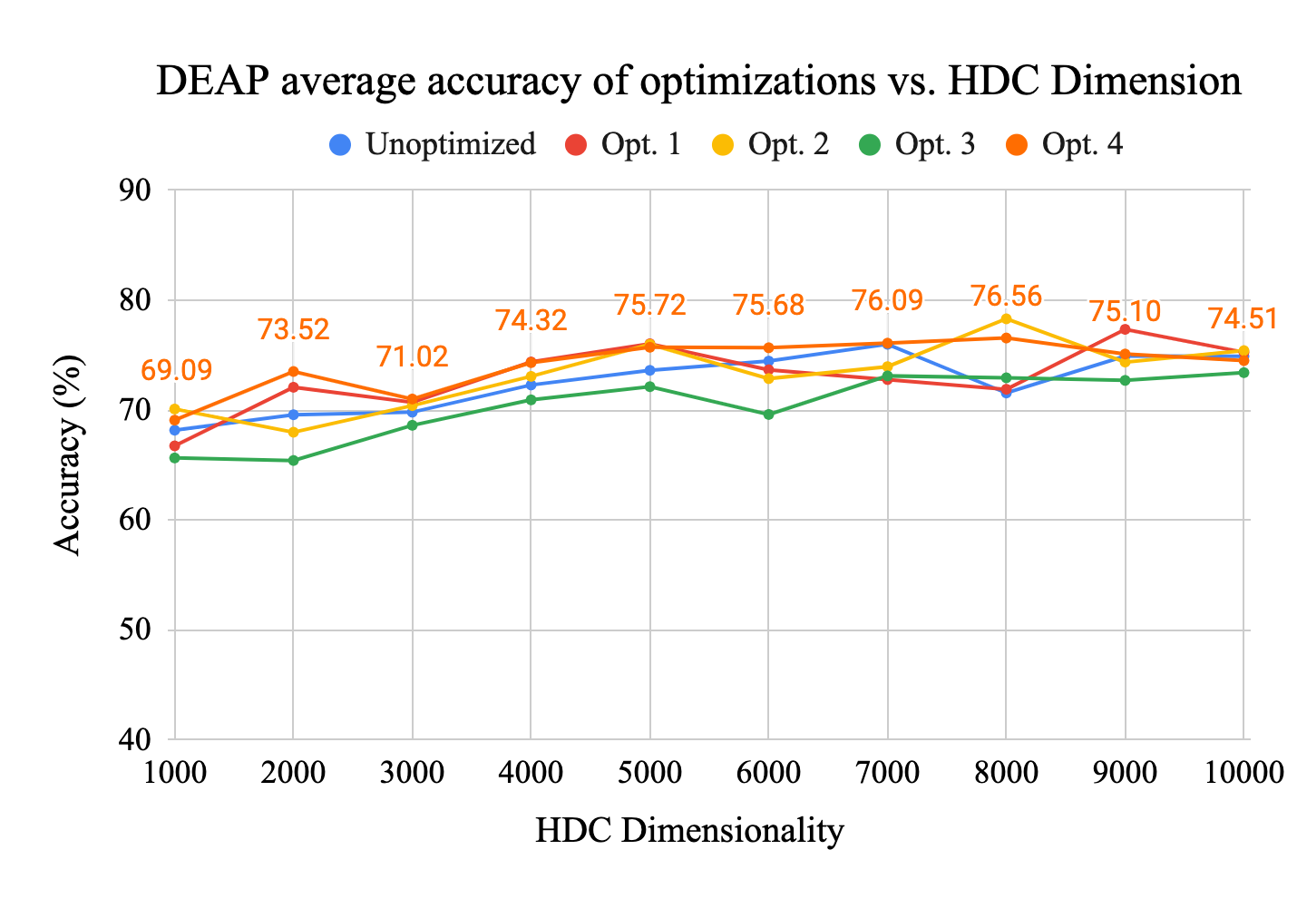
(a)
(b)

Slide 5
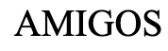
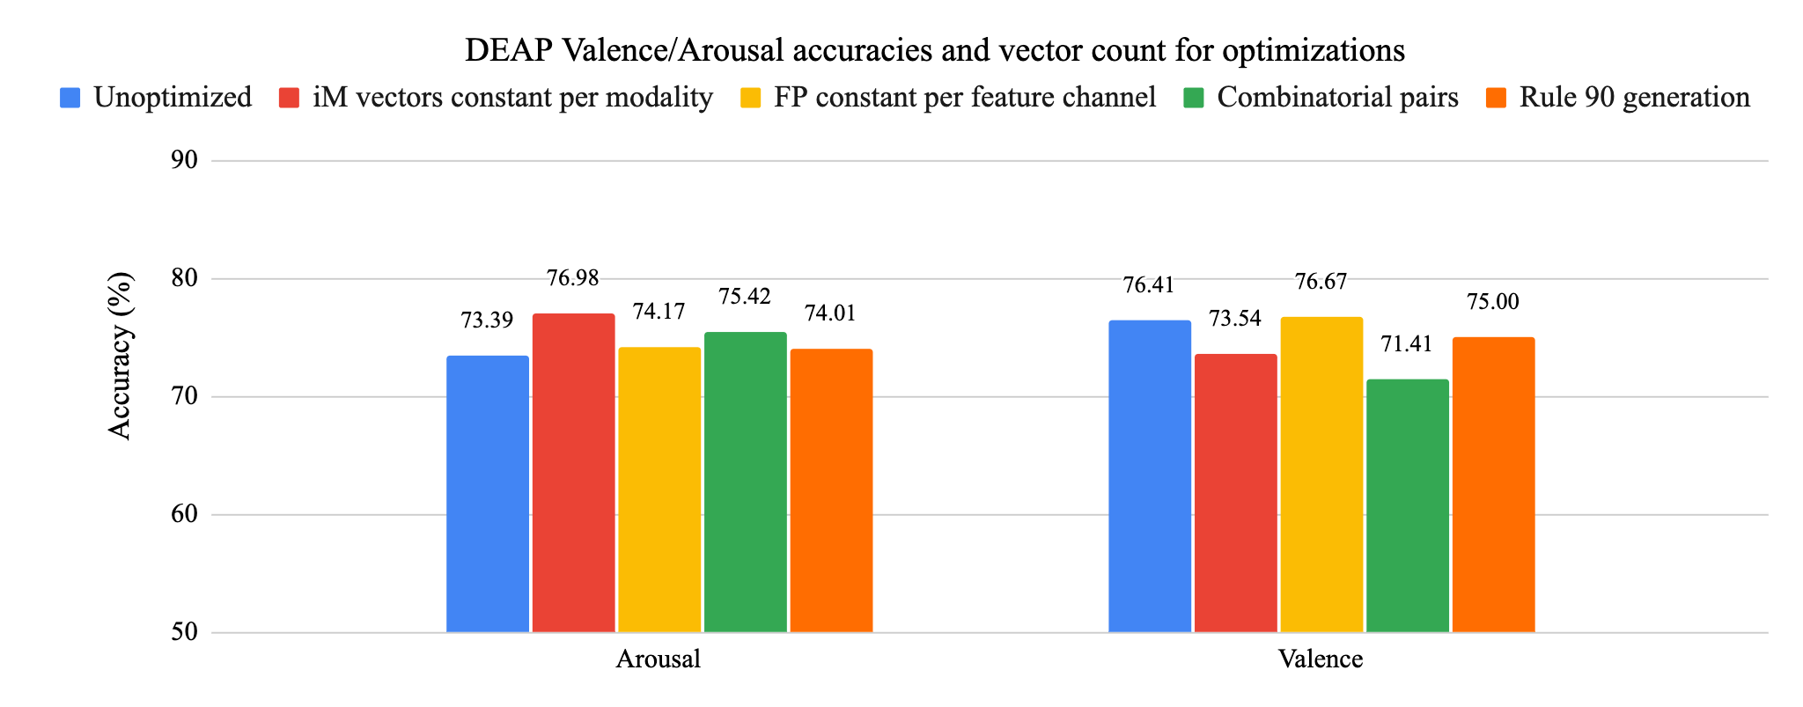
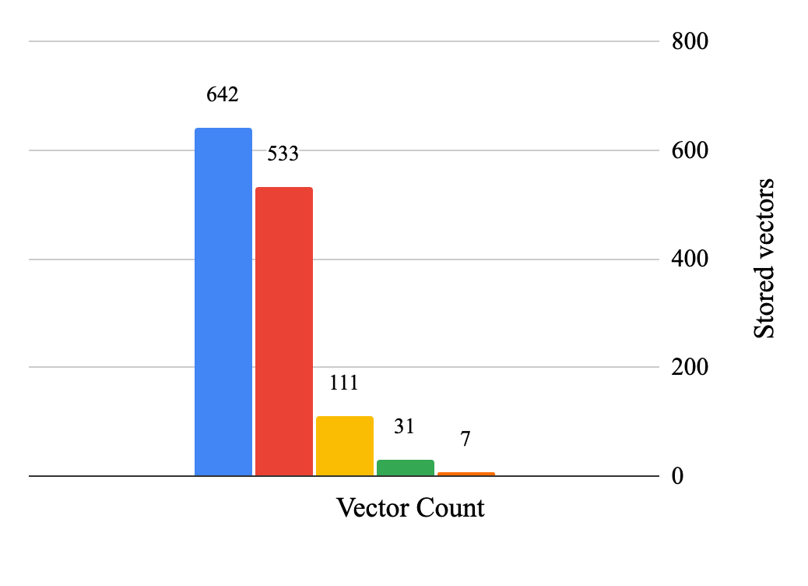
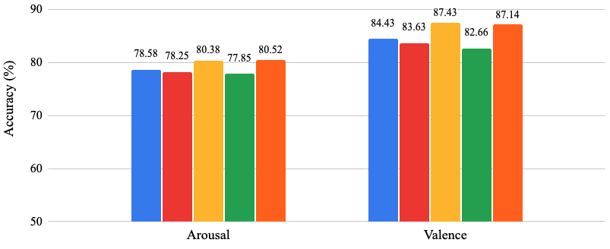
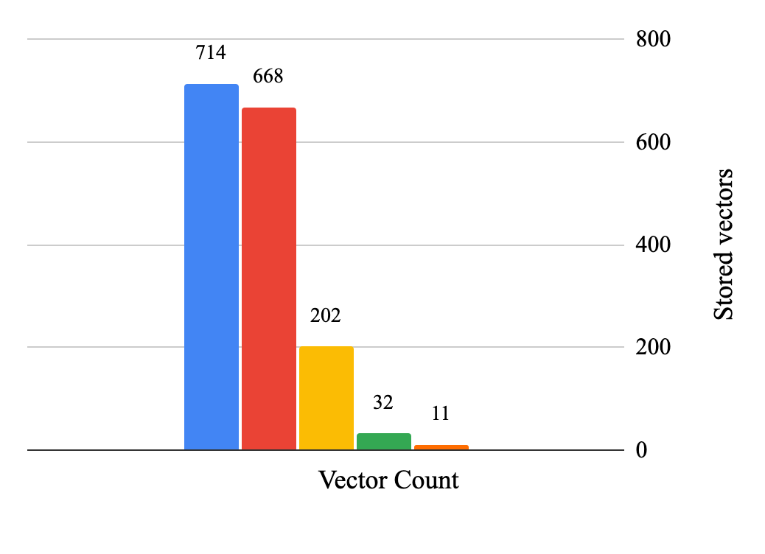
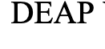
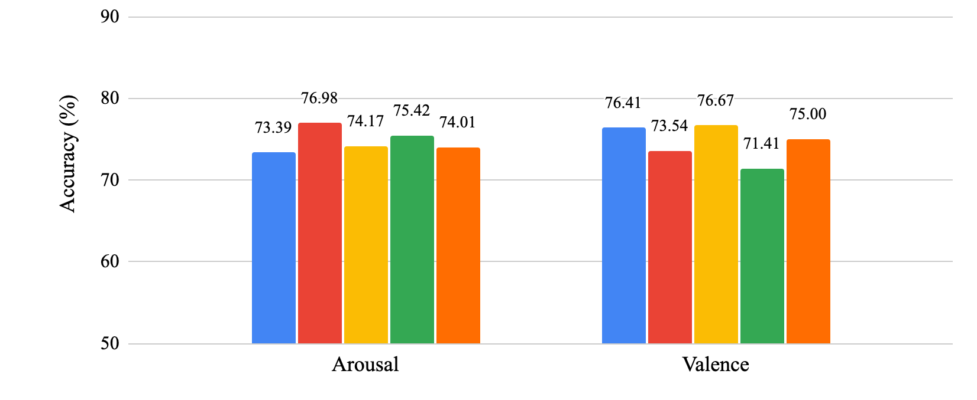
(a)
(b)

Slide 6
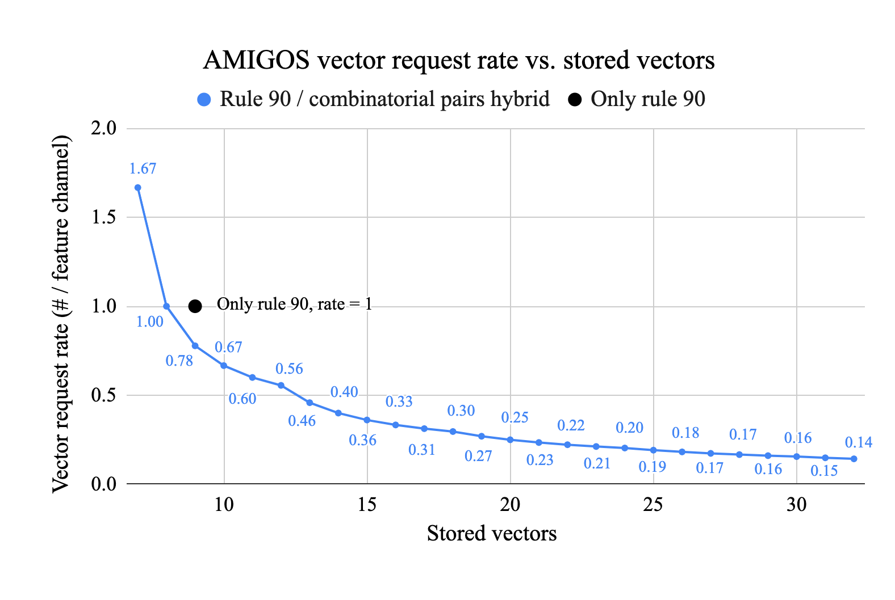
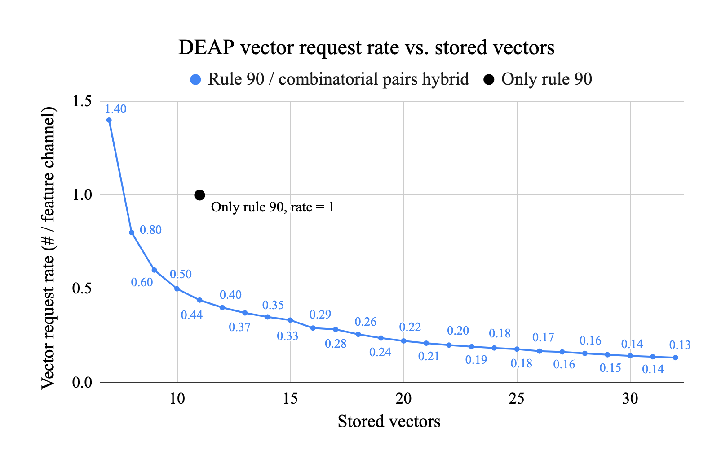
(a)
(b)

Slide 7
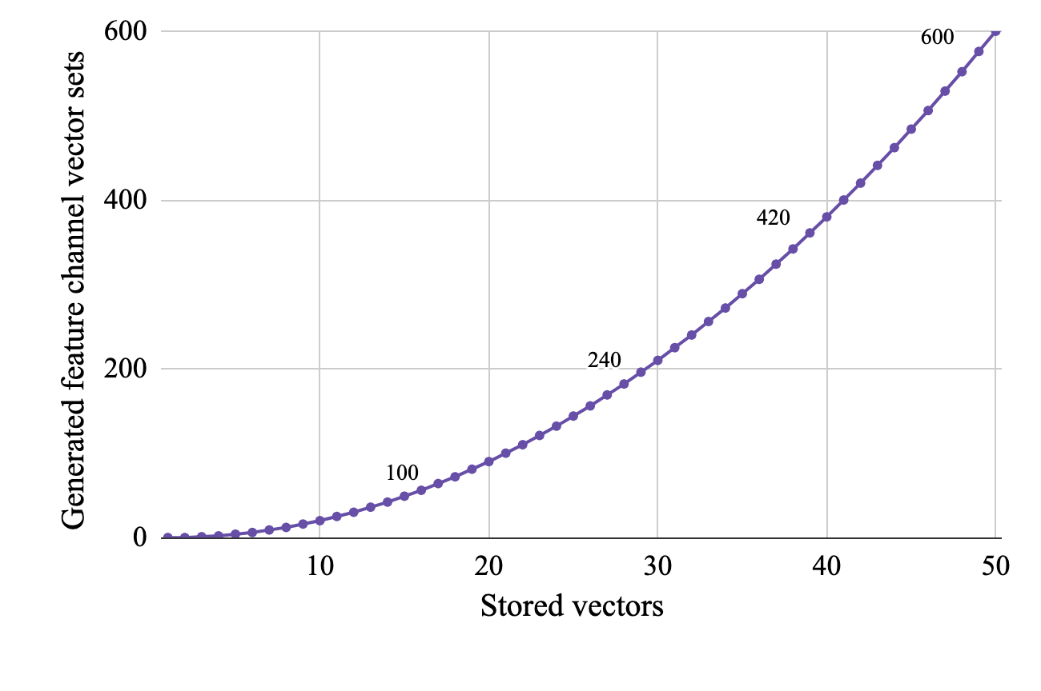

Slide 8

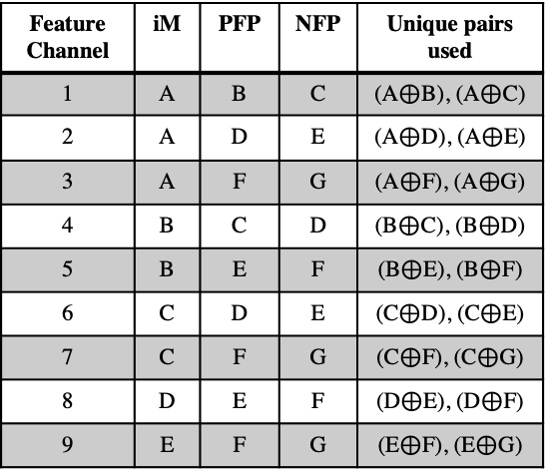
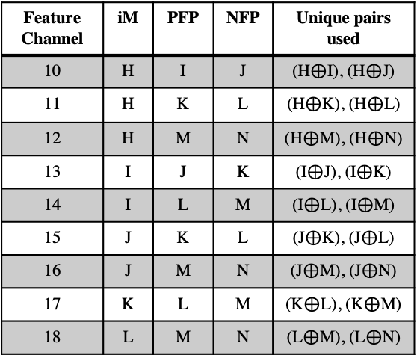





HV_{n}
HV_{n+1}
Rule 90
Stored
Vectors
Stored
Vectors
Burst:
generate x7
Burst:
generate x7
A B
C D
E F
G
H I
J K
L M
N
$ρ$⁻¹
$ρ$⁻¹
…
New seed
F
Rule 90
$$⊕$$
New seed
M
Rule 90
$$⊕$$
$ρ$⁺¹
$ρ$⁺¹
Feature Channel | iM | PFP | NFP | Unique pairs used
1 | A | B | C | (A$⊕$B), (A$⊕$C)
2 | A | D | E | (A$⊕$D), (A$⊕$E)
3 | A | F | G | (A$⊕$F), (A$⊕$G)
4 | B | C | D | (B$⊕$C), (B$⊕$D)
5 | B | E | F | (B$⊕$E), (B$⊕$F)
6 | C | D | E | (C$⊕$D), (C$⊕$E)
7 | C | F | G | (C$⊕$F), (C$⊕$G)
8 | D | E | F | (D$⊕$E), (D$⊕$F)
9 | E | F | G | (E$⊕$F), (E$⊕$G)
Feature Channel | iM | PFP | NFP | Unique pairs used
10 | H | I | J | (H$⊕$I), (H$⊕$J)
11 | H | K | L | (H$⊕$K), (H$⊕$L)
12 | H | M | N | (H$⊕$M), (H$⊕$N)
13 | I | J | K | (I$⊕$J), (I$⊕$K)
14 | I | L | M | (I$⊕$L), (I$⊕$M)
15 | J | K | L | (J$⊕$K), (J$⊕$L)
16 | J | M | N | (J$⊕$M), (J$⊕$N)
17 | K | L | M | (K$⊕$L), (K$⊕$M)
18 | L | M | N | (L$⊕$M), (L$⊕$N)
…

Slide 9
: Signal
: HD vector
GSR
Feature 1
SE input 1
Electrode 1
_{GSR Pre-processing}
_{Feature} _{extraction}
…
_{Map into}
_{HD space}
…
_{GSR spatial}
_{encoder}
Electrode 2
Feature 32
SE input 32
ECG
Electrode 1
_{ECG} _{Pre-processing}
_{Feature} _{extraction}
Feature 33
SE input 33
Fused
Hypervector
Electrode 2
…
_{Map into}
_{HD space}
…
_{ECG spatial}
_{encoder}
_{Sensor Fusion}
Electrode 3
Feature 109
SE input 109
Input to
temporal encoder
EEG
Electrode 1
_{EEG Pre-processing}
_{Feature} _{extraction}
Feature 110
_{Map into}
_{HD space}
SE input 110
…
…
…
_{EEG spatial}
_{encoder}
Electrode 14
Feature 214
SE input 214

